Slide 1
The Bigger Picture
Language Models

Slide 2
Course Contents
Deep Learning
Transformer
Finetuning
Agents
The Bigger Picture
Context Engineering
Instruction Tuning
LLMs

Slide 3
This Part: The Bigger Picture
historical context
current research directions
discussion

Slide 4
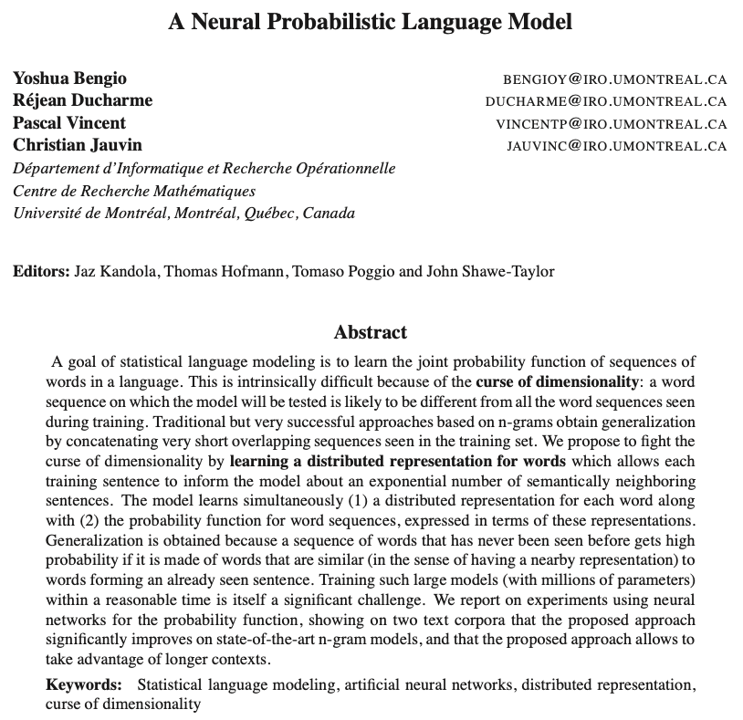
Neural Networks as Language Models
2003

Slide 5
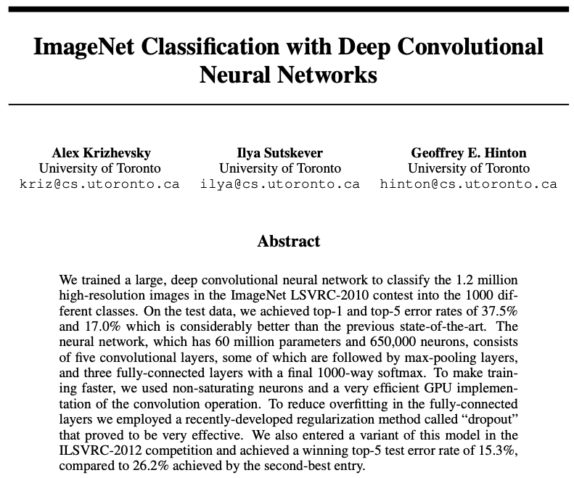
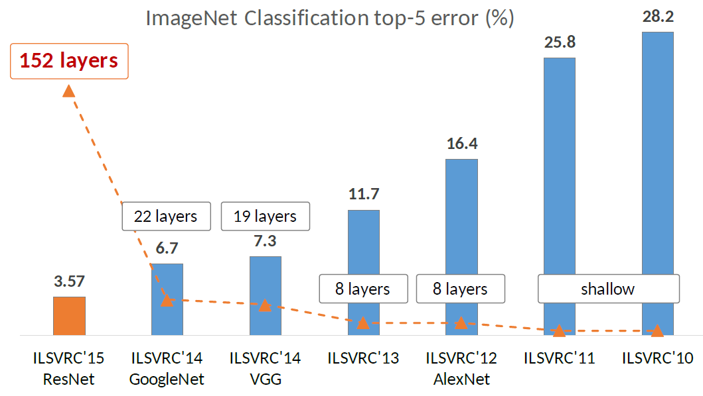
Deep Learning Rises
2012

Slide 6
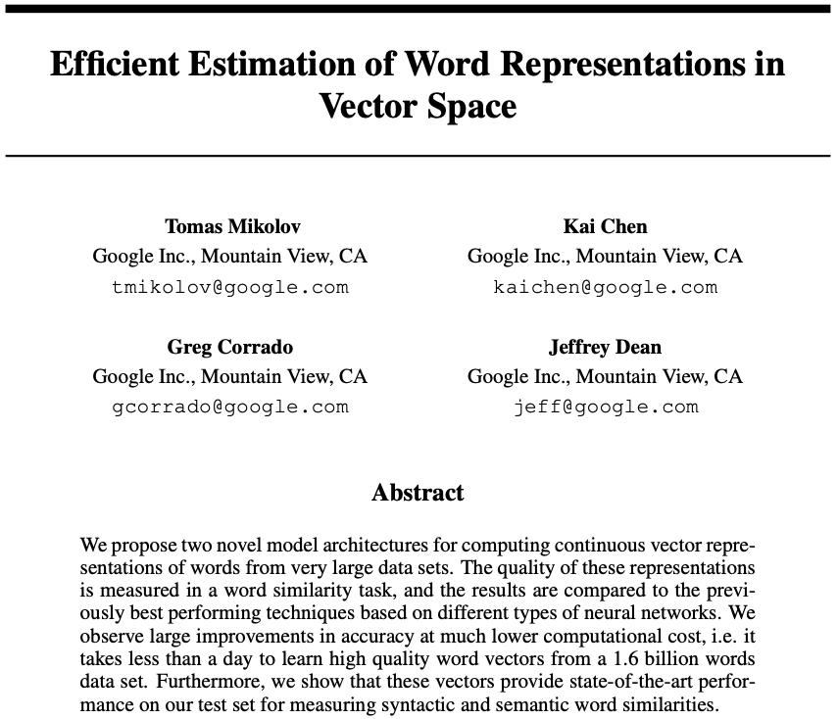
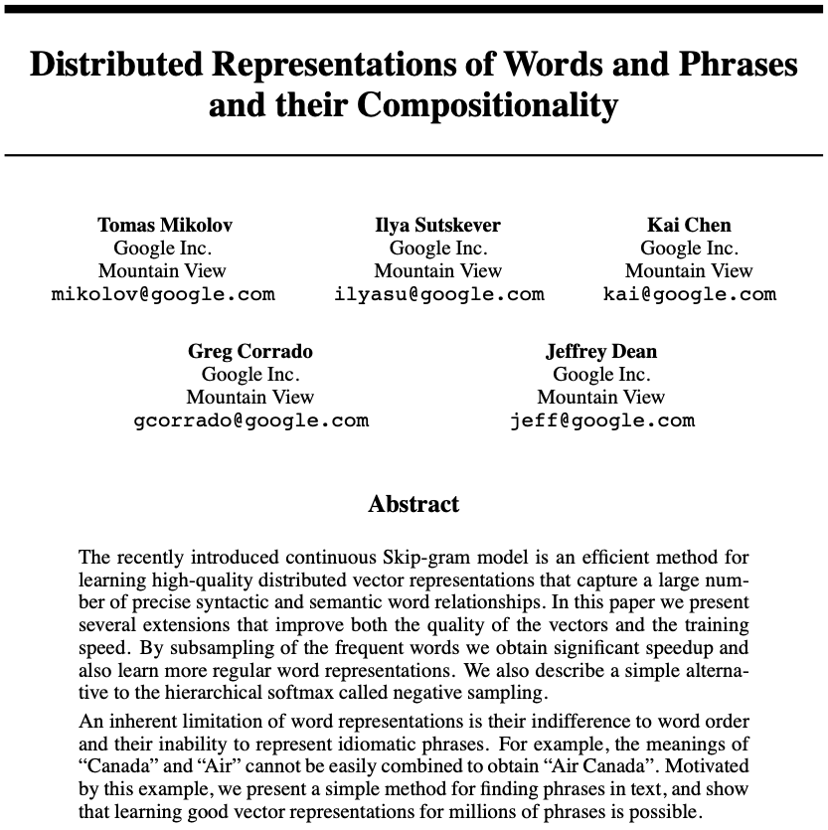
Word Embeddings
2013

Slide 7
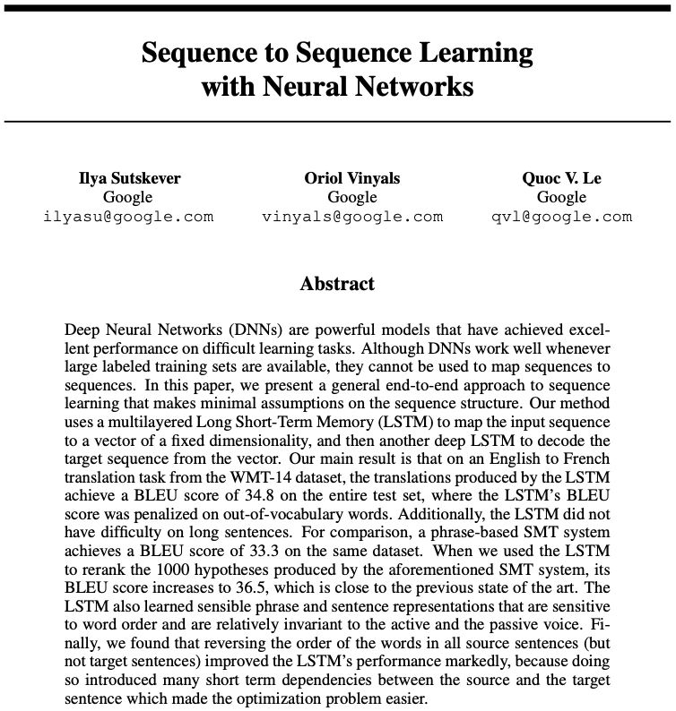
Machine Translation
2014
Once there were RNNs …

Slide 8
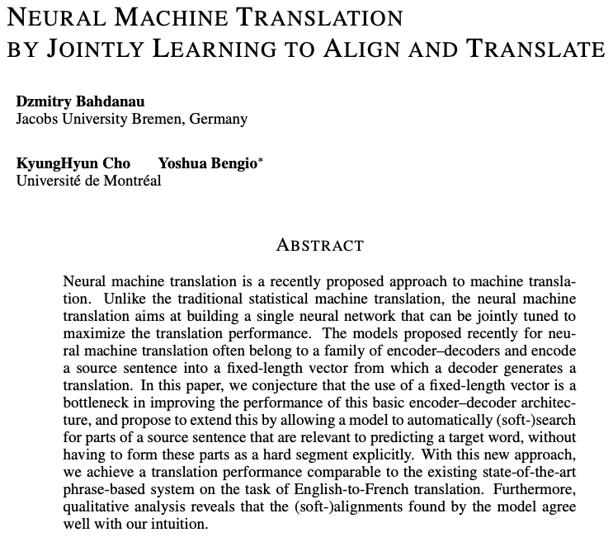

Attention Mechanism
2015

Slide 9
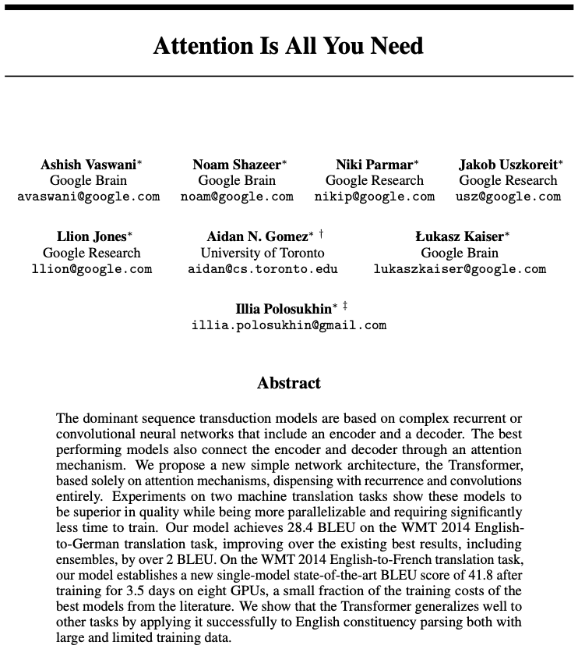

Transformers Take Over
2017

Slide 10
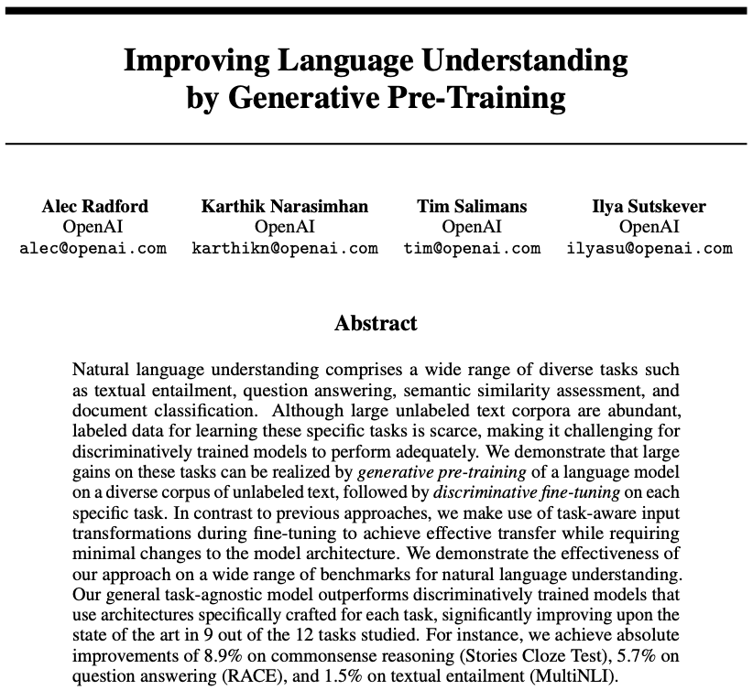
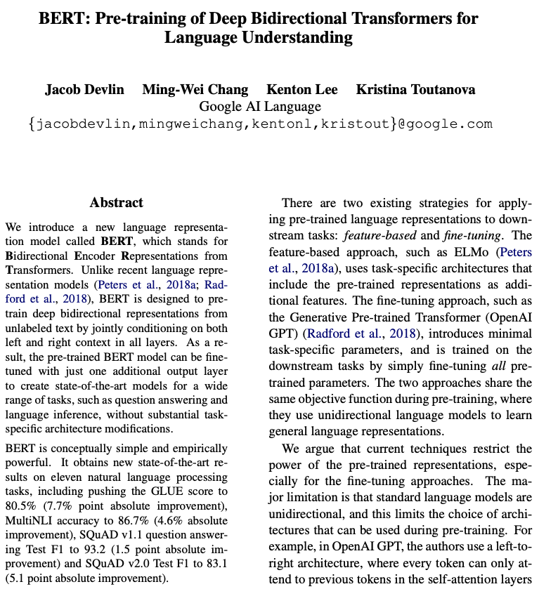
GPT & BERT
2018
self-supervised pretraining followed by supervised finetuning

Slide 11
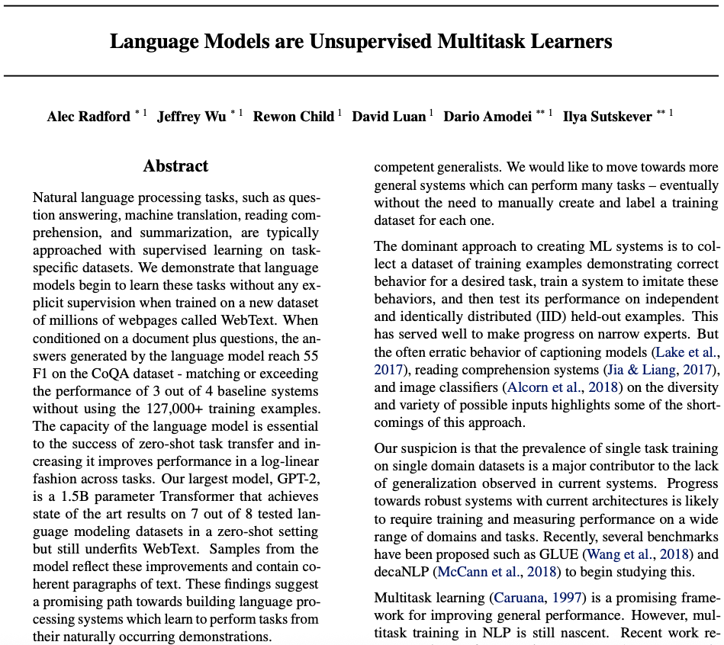
Prompting: GPT-2
2019
zero-shot & few-shot learning

Slide 12
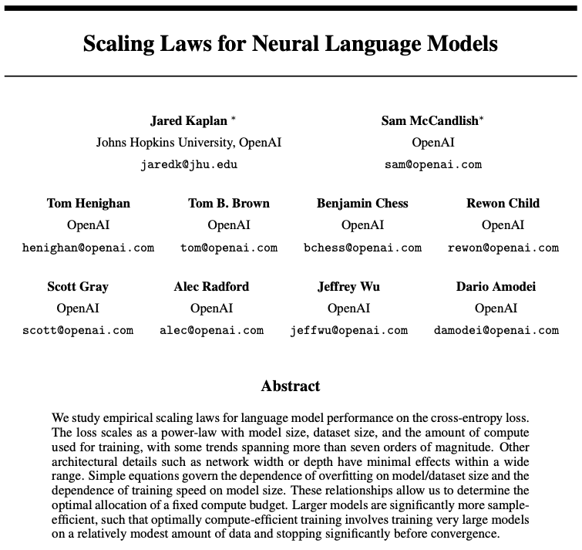
Scaling Laws
2020

Slide 13
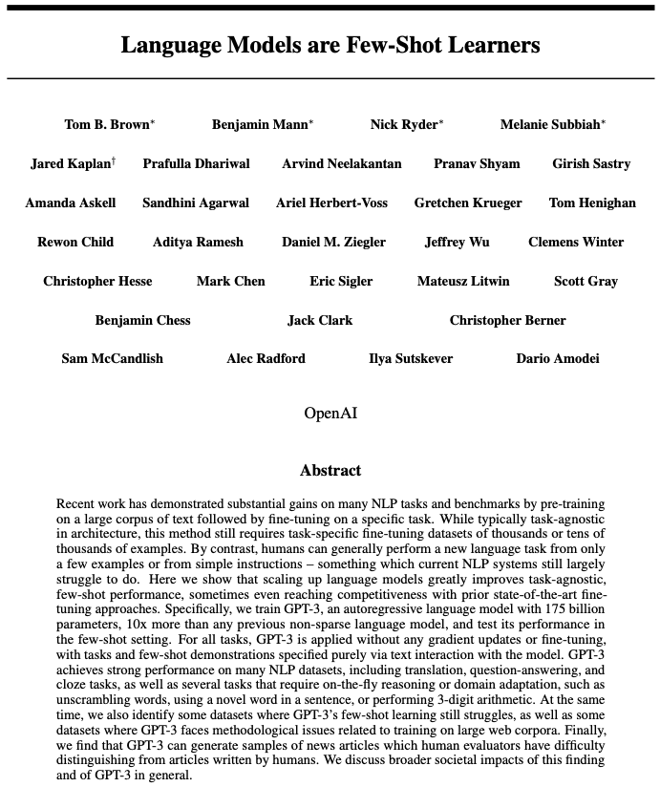
GPT-3
2020
175 billion parameters

Slide 14
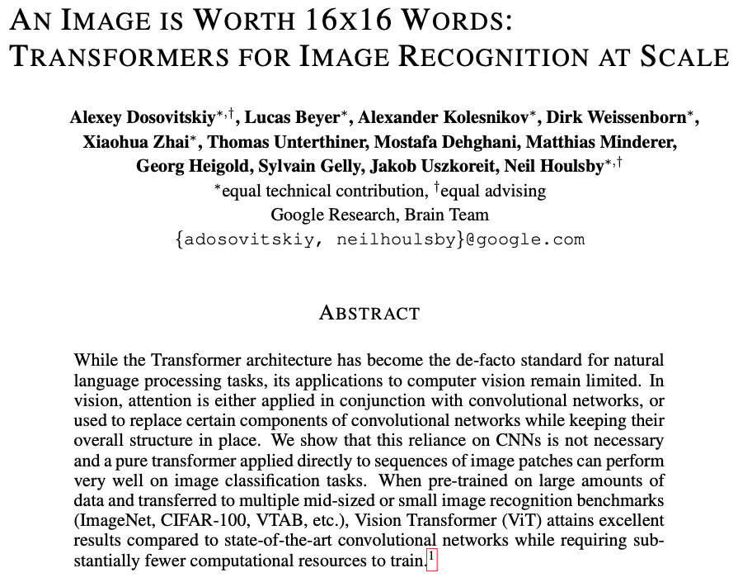

Vision Transformer
2021

Slide 15
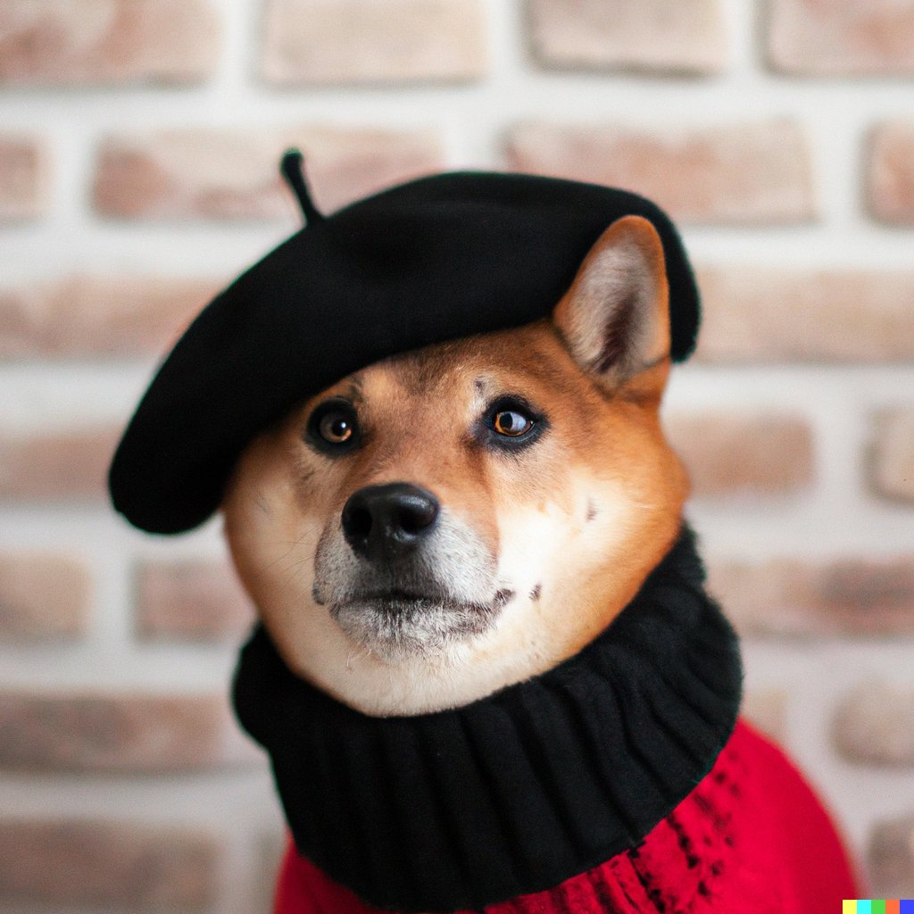
Text-to-Image: DALL-E
2021
“A Shiba Inu dog wearing a beret and black turtleneck”

Slide 16
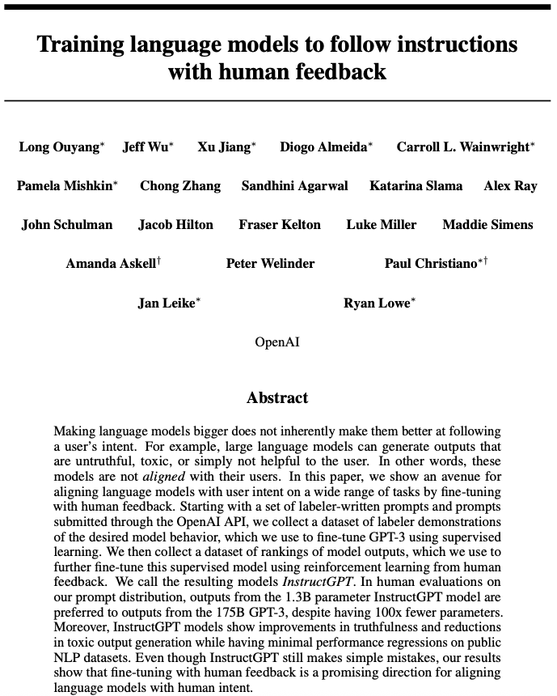
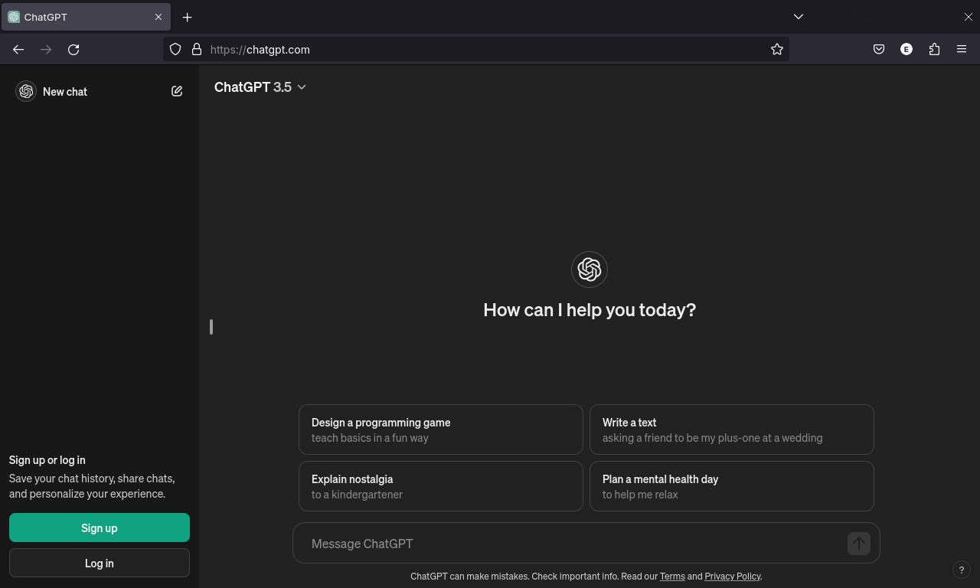
Takeoff: ChatGPT
2022

Slide 17
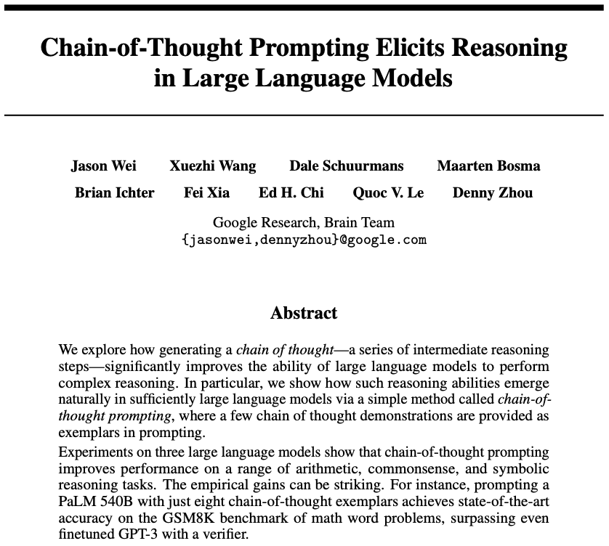
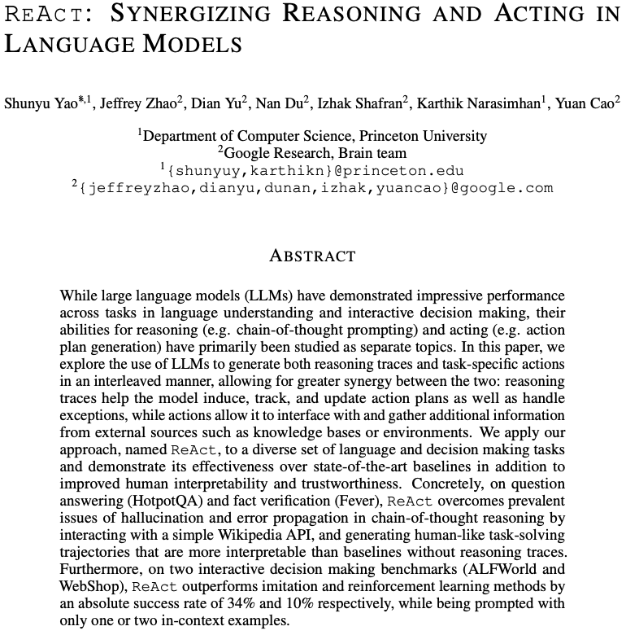
Reasoning & Tool Use
2023

Slide 18
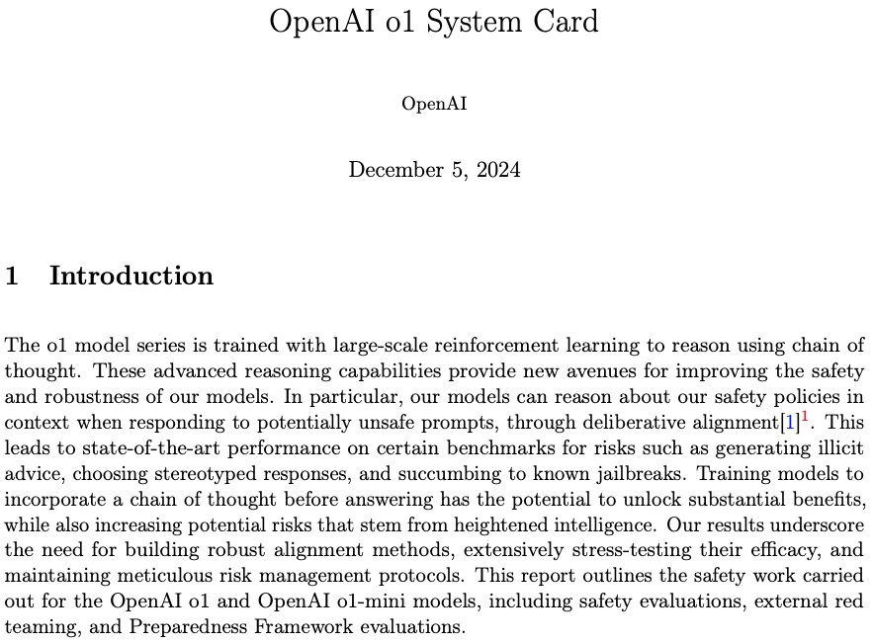
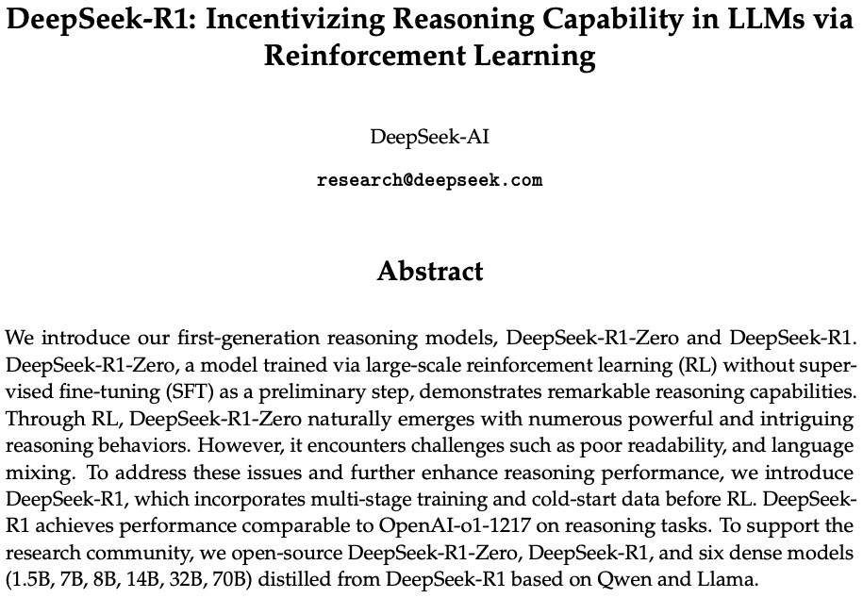
Reasoning Models
2025
test-time scaling

Slide 19
Active Research Areas
autonomous agents: memory, planning, reasoning, tool use
multimodal models: unification of text, image, video, audio
training efficiency and long-context models
expert models tuned for specific domains or tasks (SLMs)
transformer alternatives (e.g., state-space models like Mamba)

Slide 20
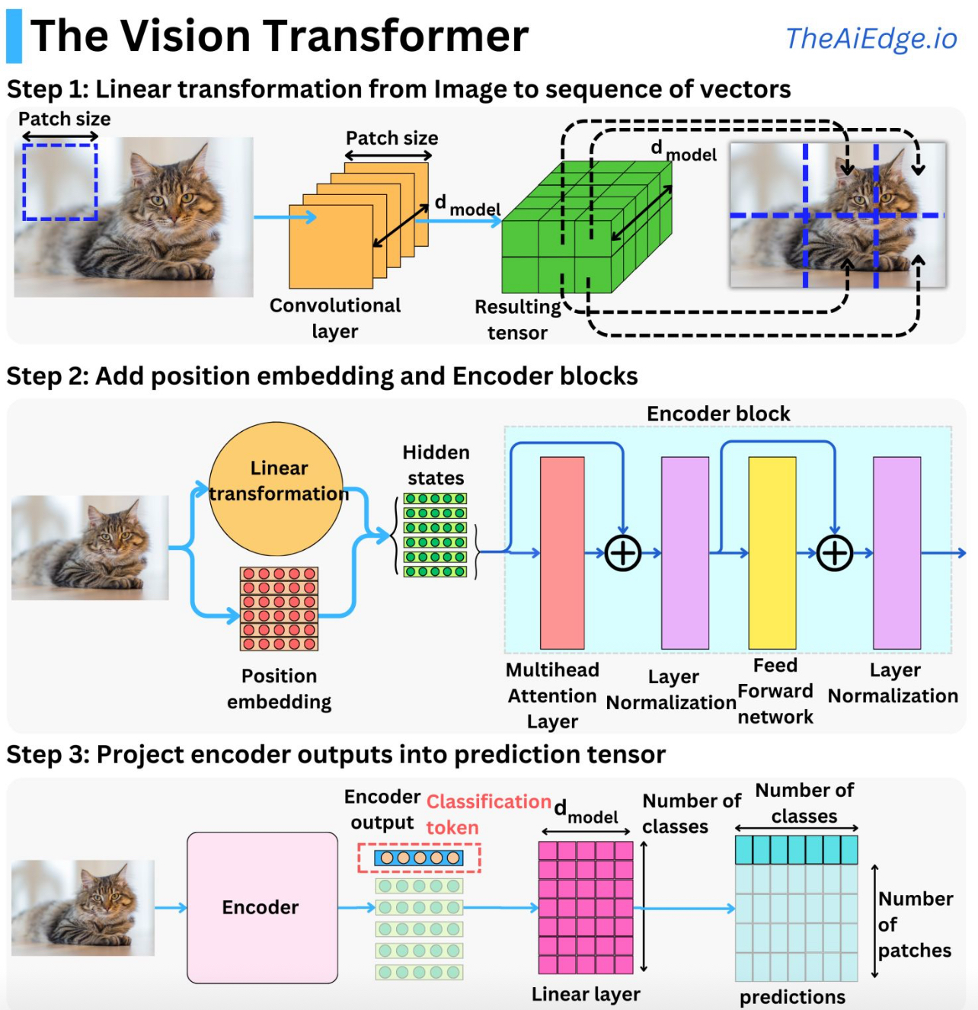
Image Classification with Vision Transformer
source
formulation as sequential problem:
split image into patches (tokens) and flatten, add positional embeddings
processing by transformer encoder:
pretrain with image labels, fine-tune on specific data set

Slide 21
Vision Language Models
visual encoder (e.g., CNNs, vision transformers):
extracts high-level features from images or video frames
text encoder (e.g., BERT, GPT):
processes and understands textual data
multimodal fusion module:
combines visual and textual representations
common techniques: cross-attention, concatenation, or joint embedding spaces
decoder or task head:
outputs results for specific tasks like image captioning or visual question answering

Slide 22

Combination of Vision and Text
example: CLIP (Contrastive Language-Image Pre-training)
learn image representations by predicting which caption goes with which image (pretraining)
→ zero-shot transfer (e.g., for image classification)
transformer
ViT
(or ResNet)
cosine similarity
joint embedding

Slide 23
example tasks: image captioning, visual question answering
BLIP2, LLaVA, …
…

Slide 24
Deep Learning for Generative AI
Depending on the application, there are currently two dominant approaches for generative AI:
text generation: decoder LLMs (autoregressive generation)
image synthesis: diffusion models
note the difference between image synthesis and multimodal understanding in LLMs (images as additional input sequences to transformer, tokenized by splitting into patches)

Slide 25

Image Synthesis
example: DALL-E 2
idea: generate new images as variations of training data (same distribution)
usually conditioned on text (prompt)
can be done with autoregressive models
but diffusion models result in way higher photorealism

